Slide 1
Microsoft AI Builder

Slide 2

Implementation complexity Access to AI needs to be made easy!

Slide 3
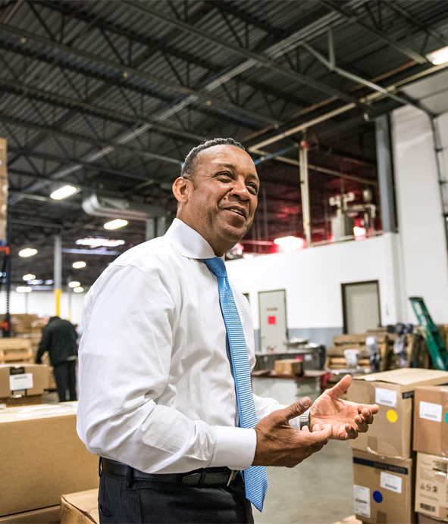
Business expertise AI’s untapped potential lies in the hands of those with business problems to solve

Slide 4
AI must be democratized to accelerate digital transformation
we are here
Paper-based
Manual
Experts
App-based
Digital
Business users
Apps + AI
Automated
Business users

Slide 5

Talent shortage But most of them lack access to data scientists and pro-developers

Slide 6


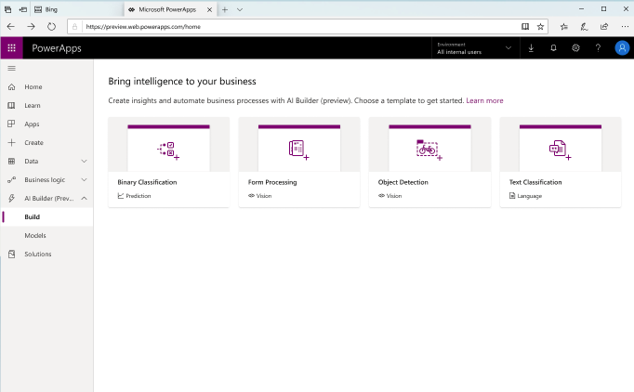
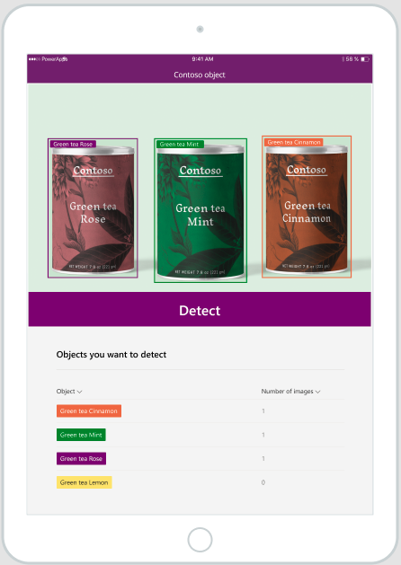
AI Builder AI for every app. And everyone. ​

Slide 7
Microsoft PowerApps AI Builder - Supported regions
Currently, AI Builder is available in United States and Europe only. AI Builder features will not be available in environments created outside United States or Europe.
AI Builder was released for public preview on June 10, 2019 in Europe and United States.
https://docs.microsoft.com/en-us/ai-builder/availability-region

Slide 8
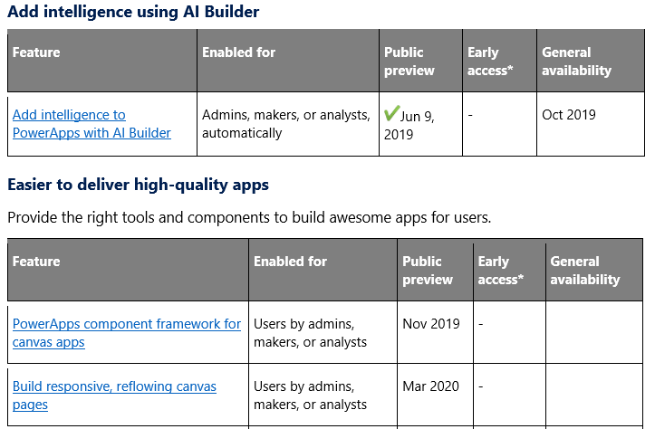
Microsoft PowerApps AI Builder – Delivery timelines

Slide 9
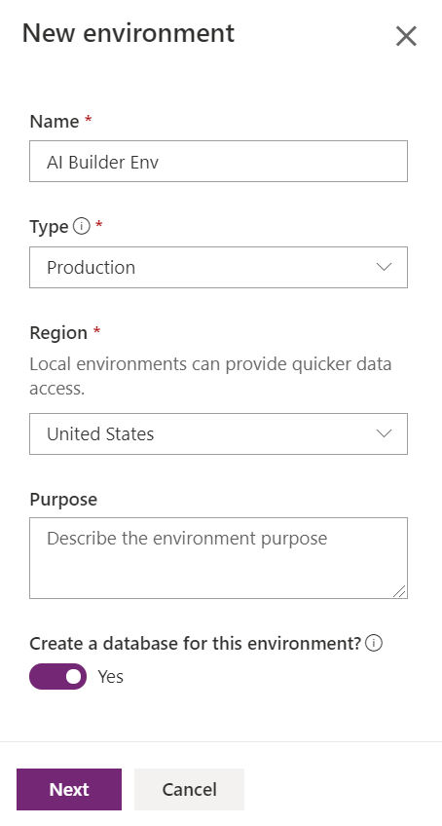
Setup Environment
Create new environment
Select region United States or Europe
Select Yes on create a database for this environment

Slide 10
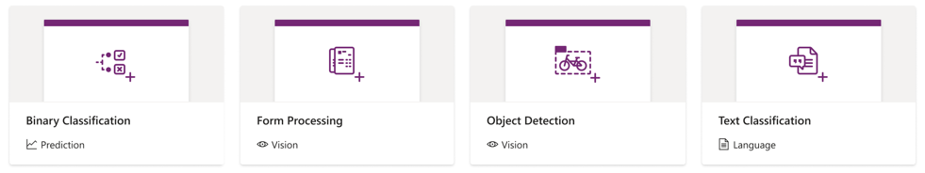
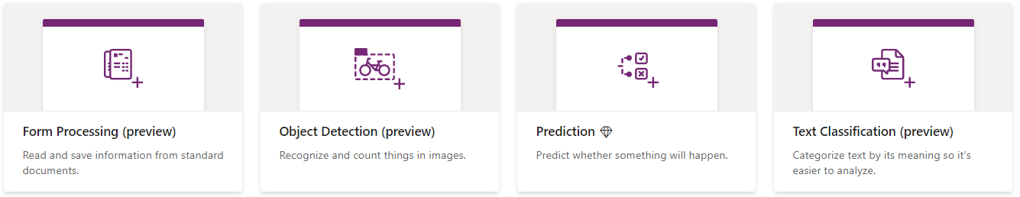
Types of AI Model - Add Intelligence to your business
Now
Notes:
Binary Classification

Slide 11
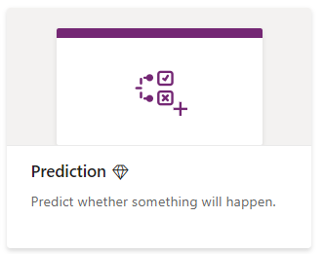


Prediction
Predict yes/no business outcomes based on
historical data patterns with historical outcomes.
Examples
Will this customer churn (yes/no)?
Which loan risk profile for this customer (low/high)
AI builder
< 1 hour
Point & Click
Process
Automation

Slide 12
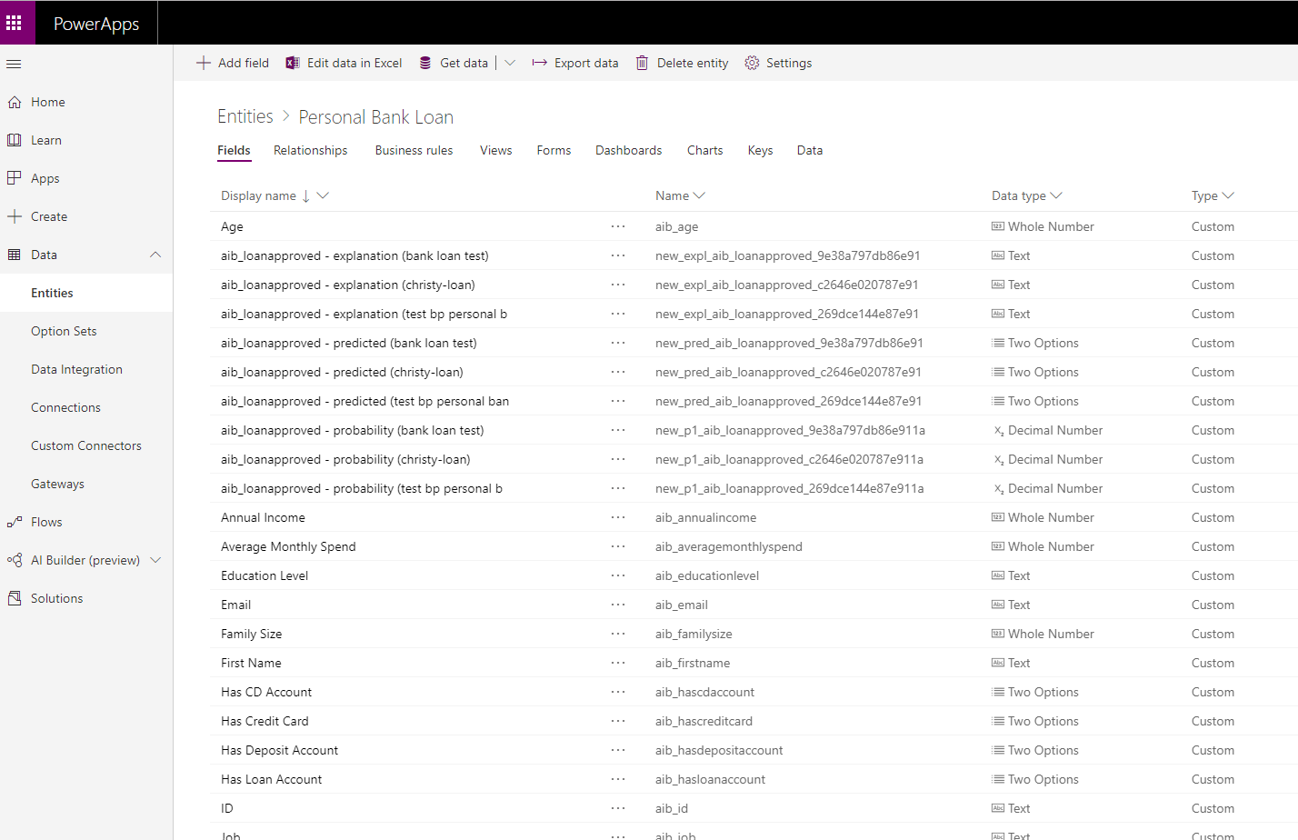
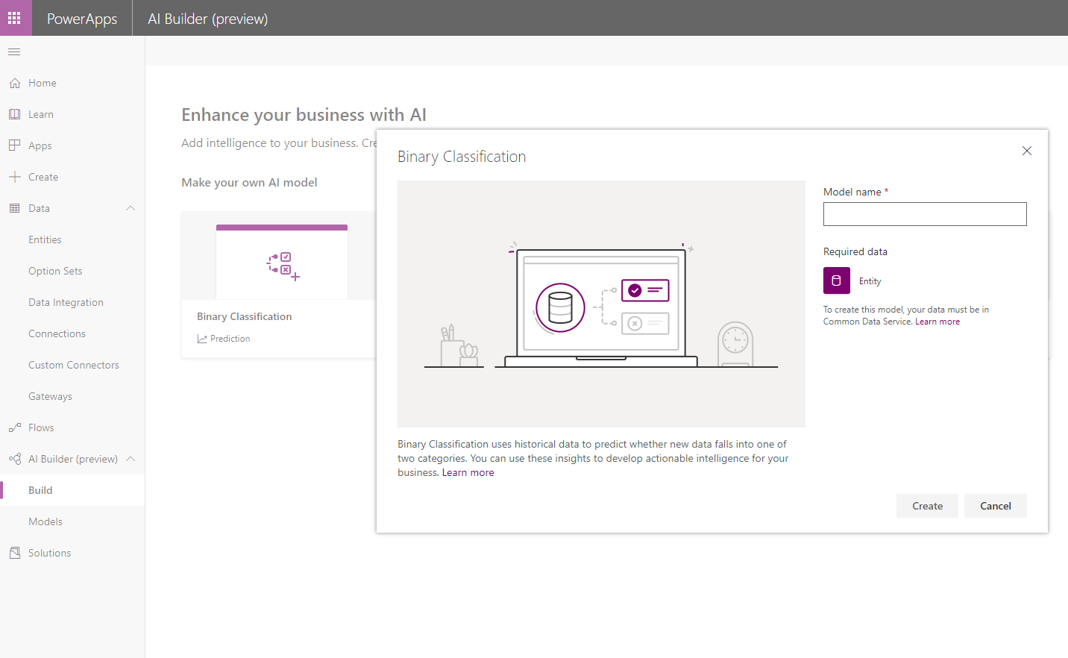


Bring in your unique business data: Historical outcomes and data
Point and click experience to build your unique AI classification model
Enhance your apps or flows with your predictions

Slide 13
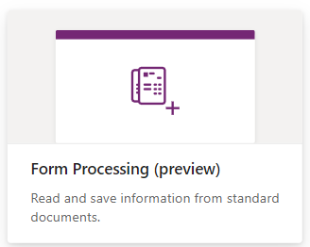
Form processing
Digitize your Forms to extract information,
store or process them​
Examples
Extract tax form information from PDF files
Extract invoice information from camera

Slide 14
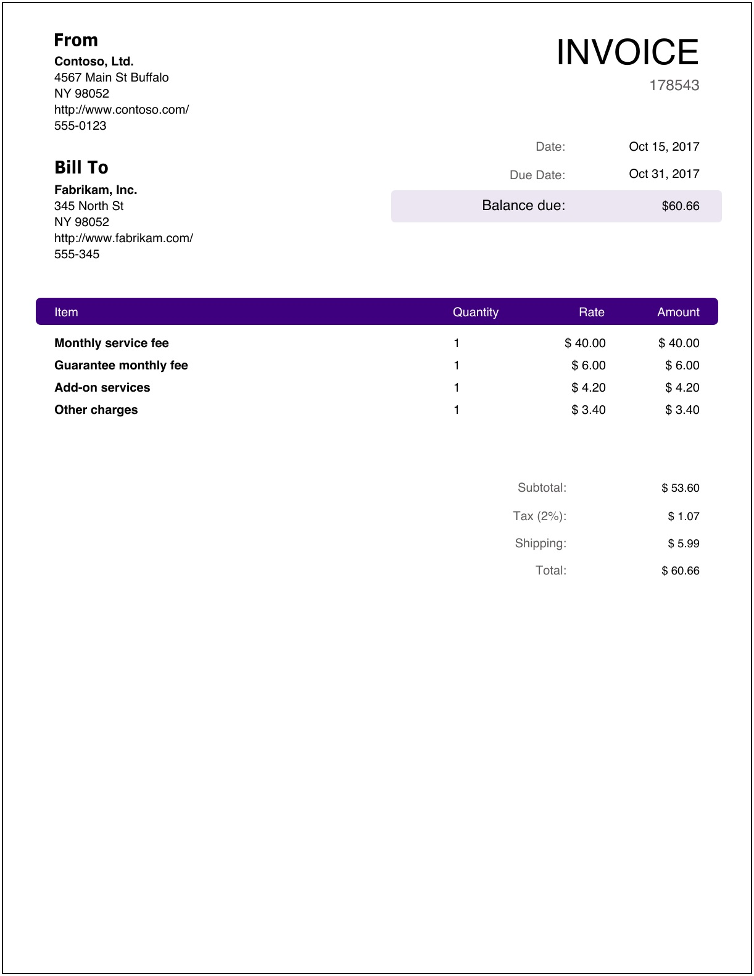
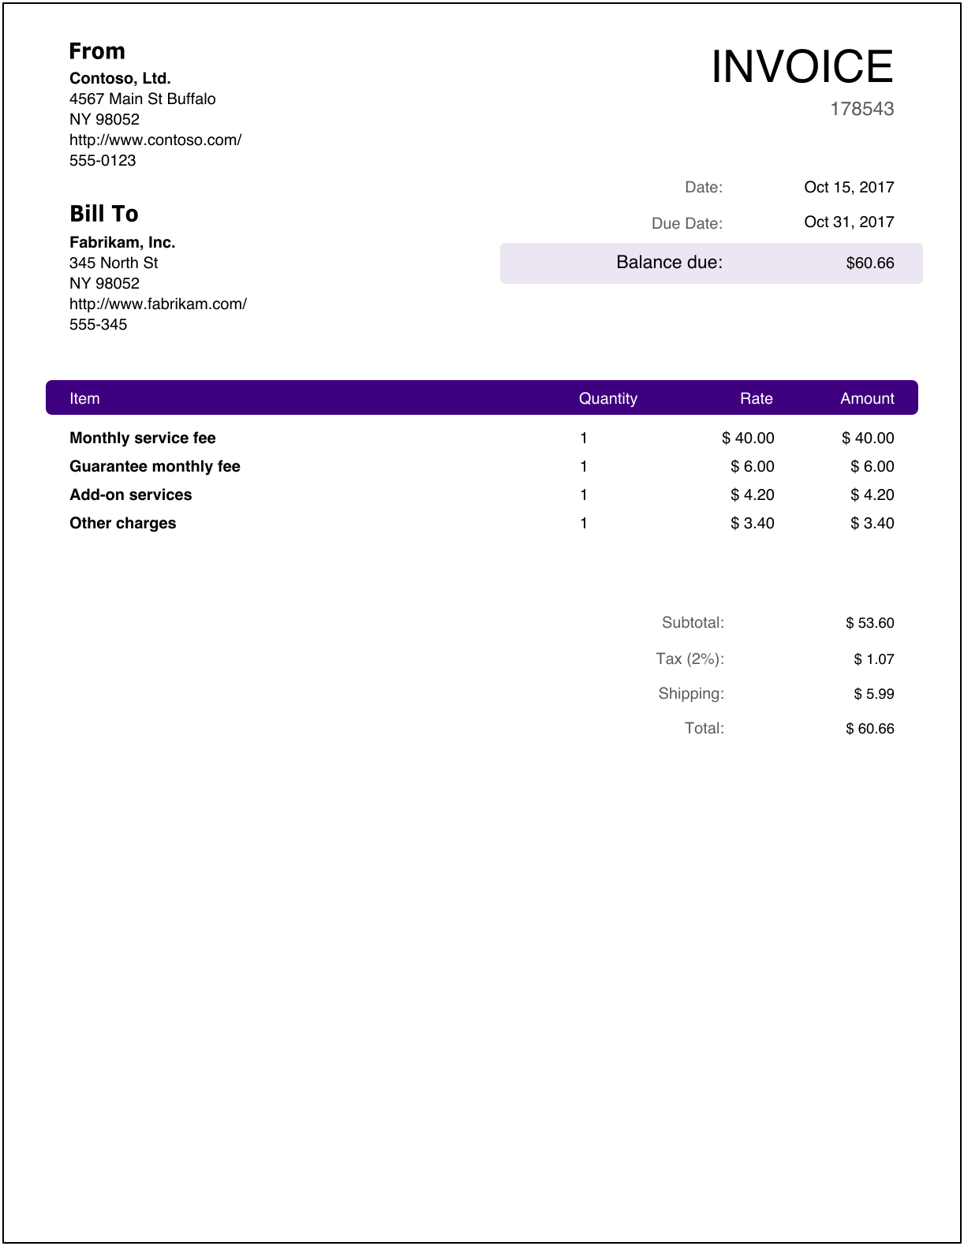

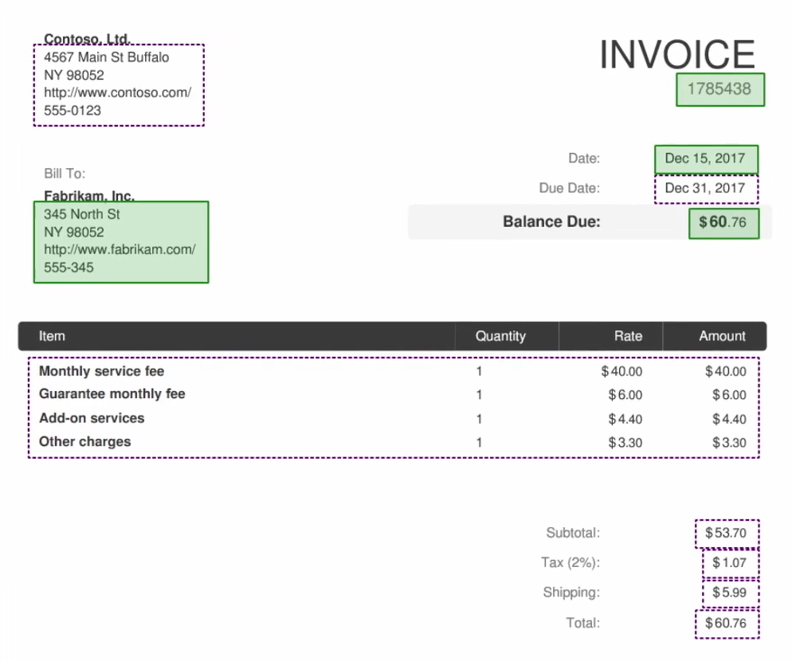
Point and click experience to build a model for a specific Form
Select the information you want to extract from that Form
Automate this Form processing using Microsoft Flow or PowerApps

Slide 15
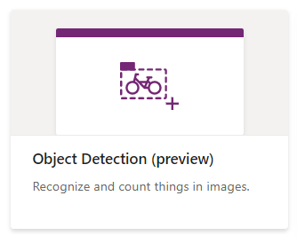
Object detection
Identify, count and locate objects in images​
Examples
Retail: product inventory detection from smartphone camera
Manufacturing: recognize parts of a machine

Slide 16

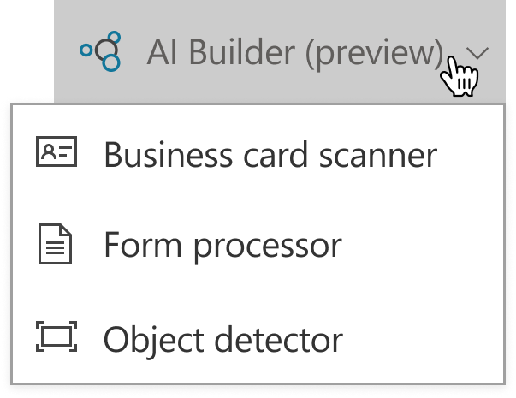
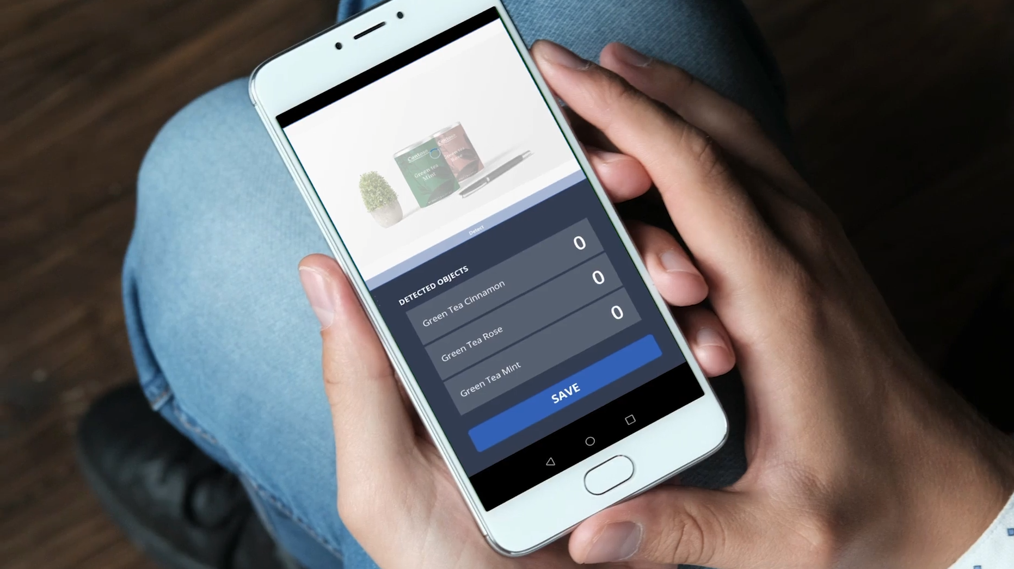
Point and click experience to build your unique AI model
Use pre-built PowerApps components to easily leverage your AI
Publish your application and all users will be able to consume your unique AI solution

Slide 17
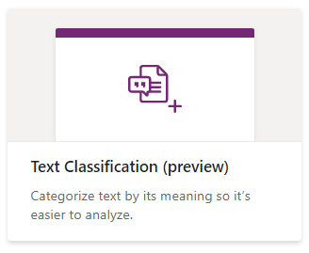
Text classification
Social media
Email
Documents
Feature request
Bug
Search
Automate text tagging to improve processes and extract untapped value from your data
Examples
Classify product feedback from customers
Route customer requests
…
…
…
…
…
…
…
…

Slide 18
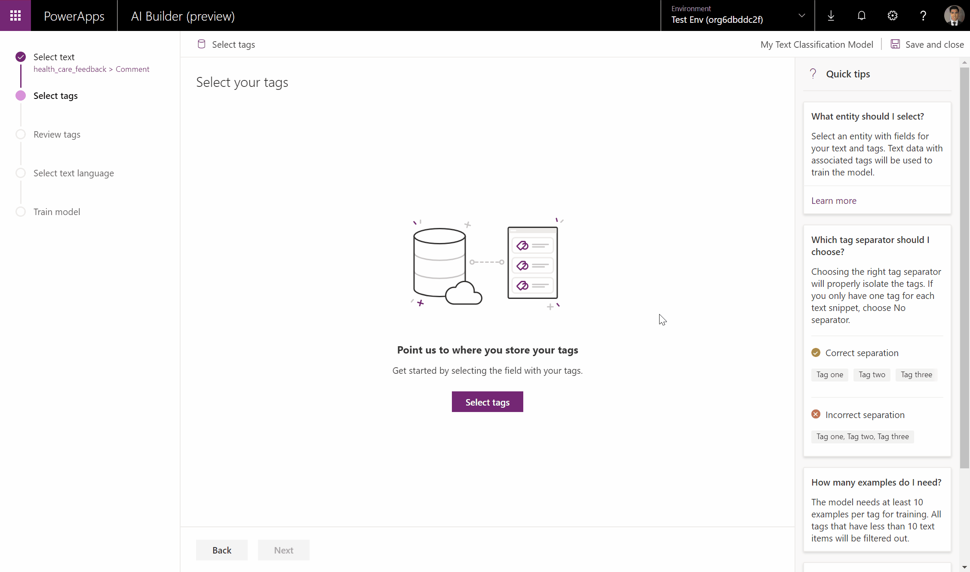
Bring in your unique business data: Text & Tags
…
…
…
…
…
…
Point and click experience to build your unique AI classification model
Automate your text processing using Microsoft Flow and your AI model
…
AI
…
…

Slide 19
Demo & Hands-on

Slide 20


AI Builder
Easy to use
Guided point and click AI applications
Empowering
AI for every skill level
Extensible
Embedded within the Power Platform and Dynamics 365
No need to manage AI infrastructure & complexity
Security, compliance, user roles

Slide 21
Reference
https://github.com/microsoft/PowerApps-Samples/tree/master/ai-builder
https://github.com/MicrosoftDocs/powerapps-docs/tree/live/powerapps-docs

